Slide 1
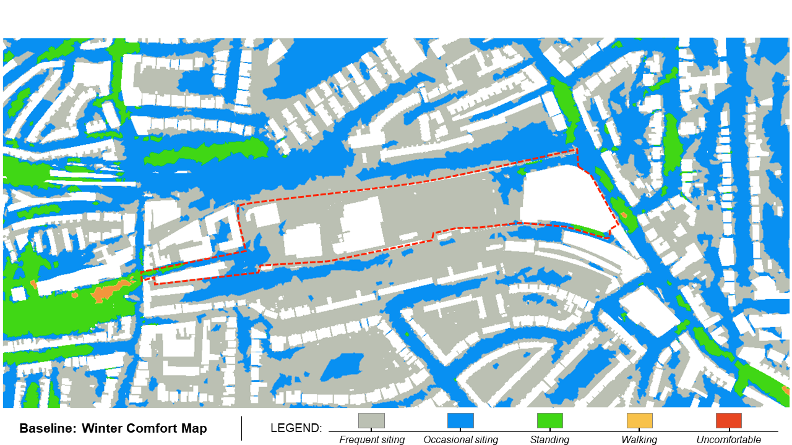

Slide 2
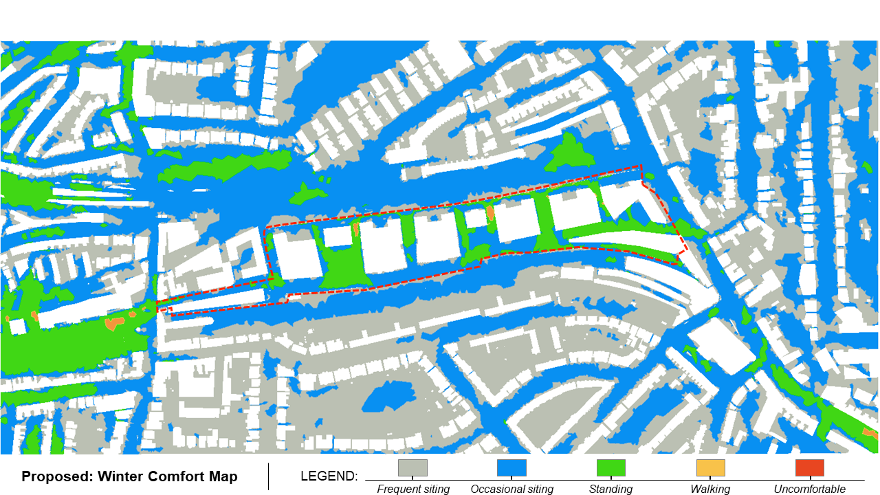

Slide 3
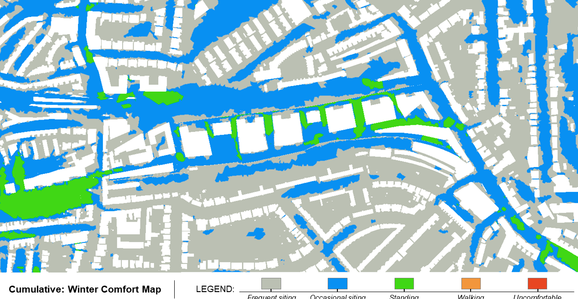

Slide 4
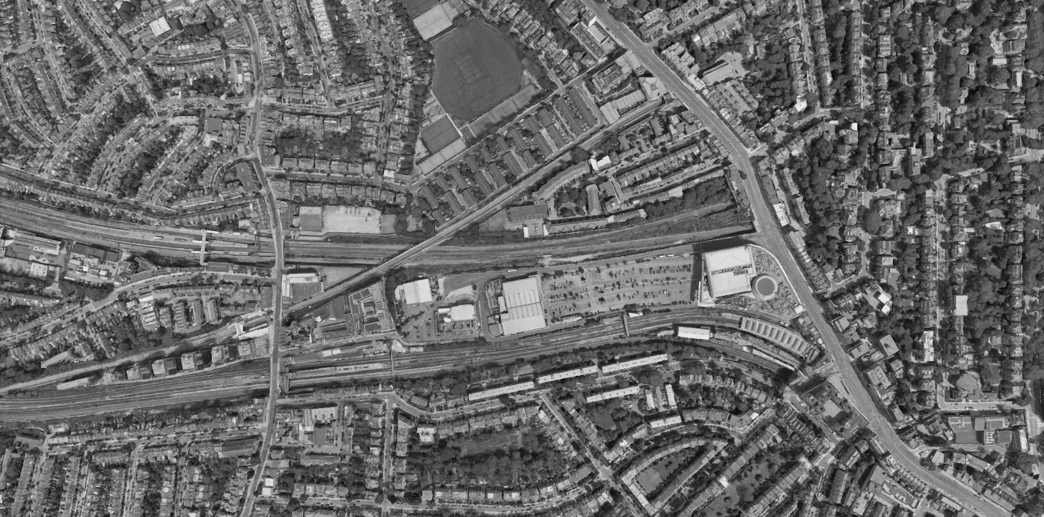
West Hampstead Lane
Finchley Road
Bus Stops
Broadhurst Gardens
Pedestrian Crossings
Canfield Gardens

