Slide 1
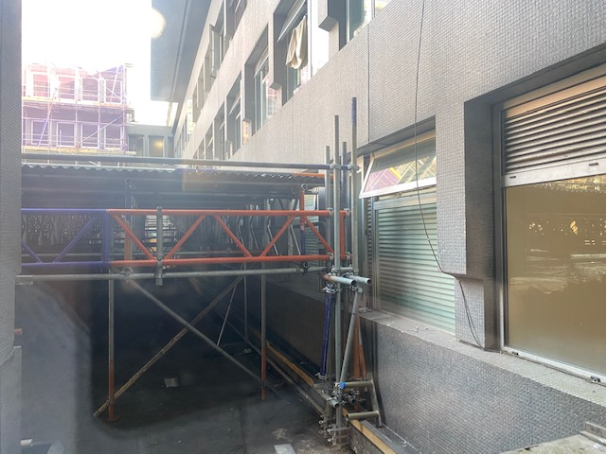
Residents windows blocked by the temporary roof on the East side.

Slide 2
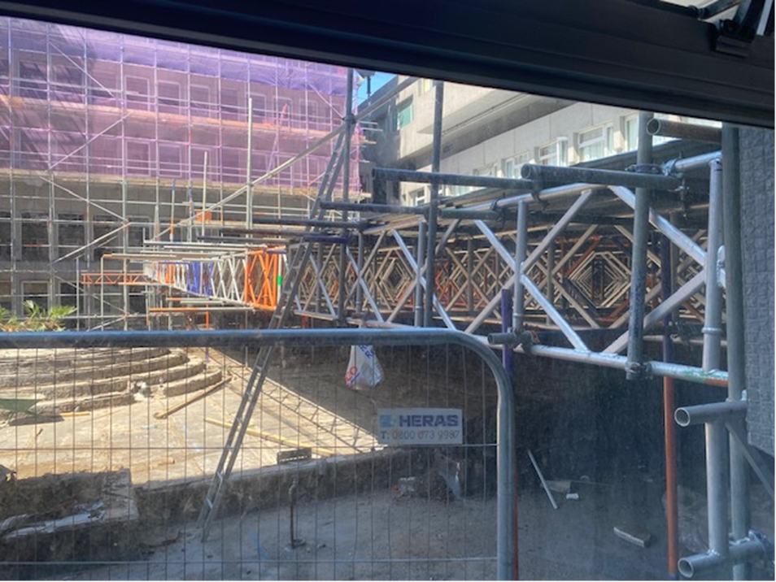
Temporary roof – you can see how close it will be to my window once it moves across and how it will completely cover my windows

Slide 3
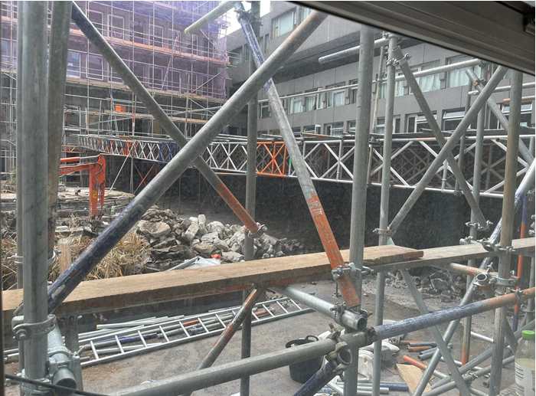
Scaffolding erected outside my window – taking from inside the flat

Slide 4
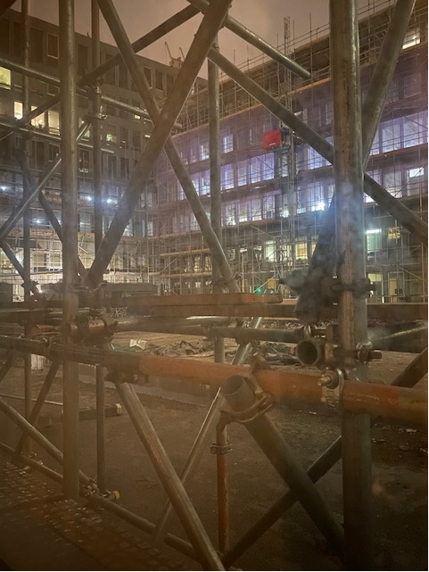
Light pollution – picture taken at night without a flash

