Slide 1
Vodafone 87661 coverage
London Design Team

Slide 2
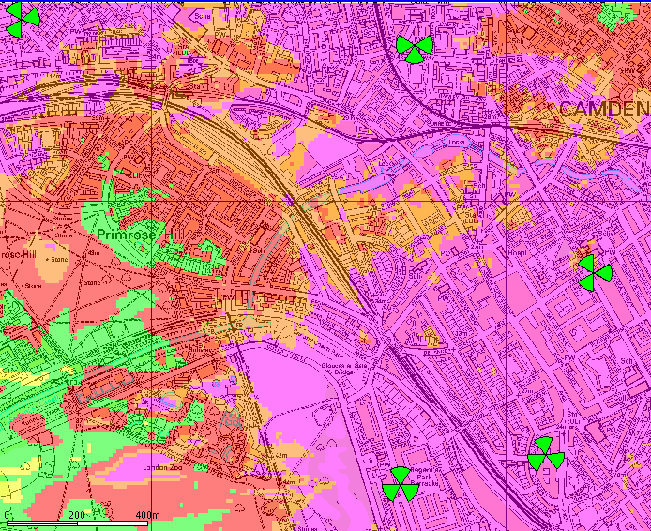
3G existing coverage
Indoor Dense Urban
Indoor Urban
Indoor Suburban
In Car
Outdoor

Slide 3
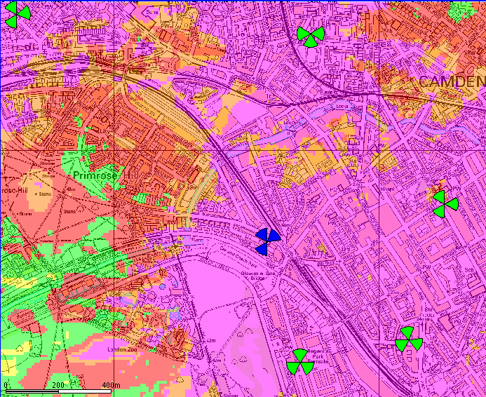
3G future coverage with new VF site 87661
Indoor Dense Urban
Indoor Urban
Indoor Suburban
In Car
Outdoor

Slide 4
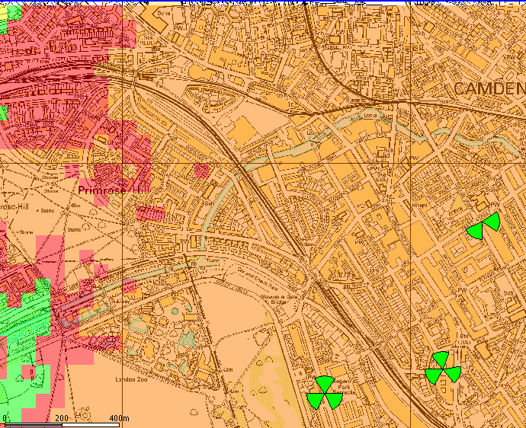
2G existing coverage
Indoor Dense Urban
Indoor Urban
Indoor Suburban
In Car
Outdoor

Slide 5
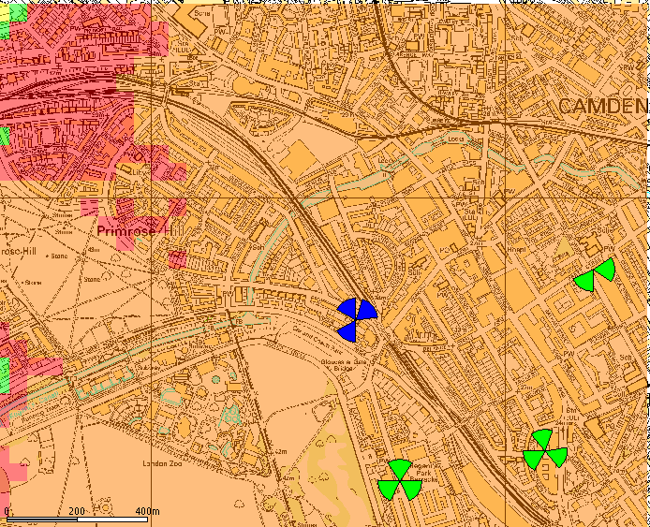
2G future coverage with new VF site 87661
Indoor Dense Urban
Indoor Urban
Indoor Suburban
In Car
Outdoor

