Slide 1
Royal College Street / Baynes Street
Proposed revised changes to existing structure Planning ref; ….......
Reduced quantity of posters & smaller frames, allowing visual observation into the site for community safety and security purposes
Application of mesh screening to improve the visual aesthetic, whilst allowing visual observation
Blocking off of possible access under the gates
Installation of anti climbing spikes along the whole perimeter
Dangerous structure / keep out signage installed
Additional Charity awareness panel installed

Slide 2
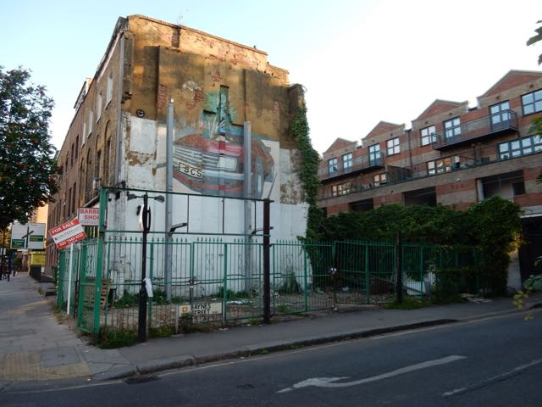
Original Condition

Slide 3
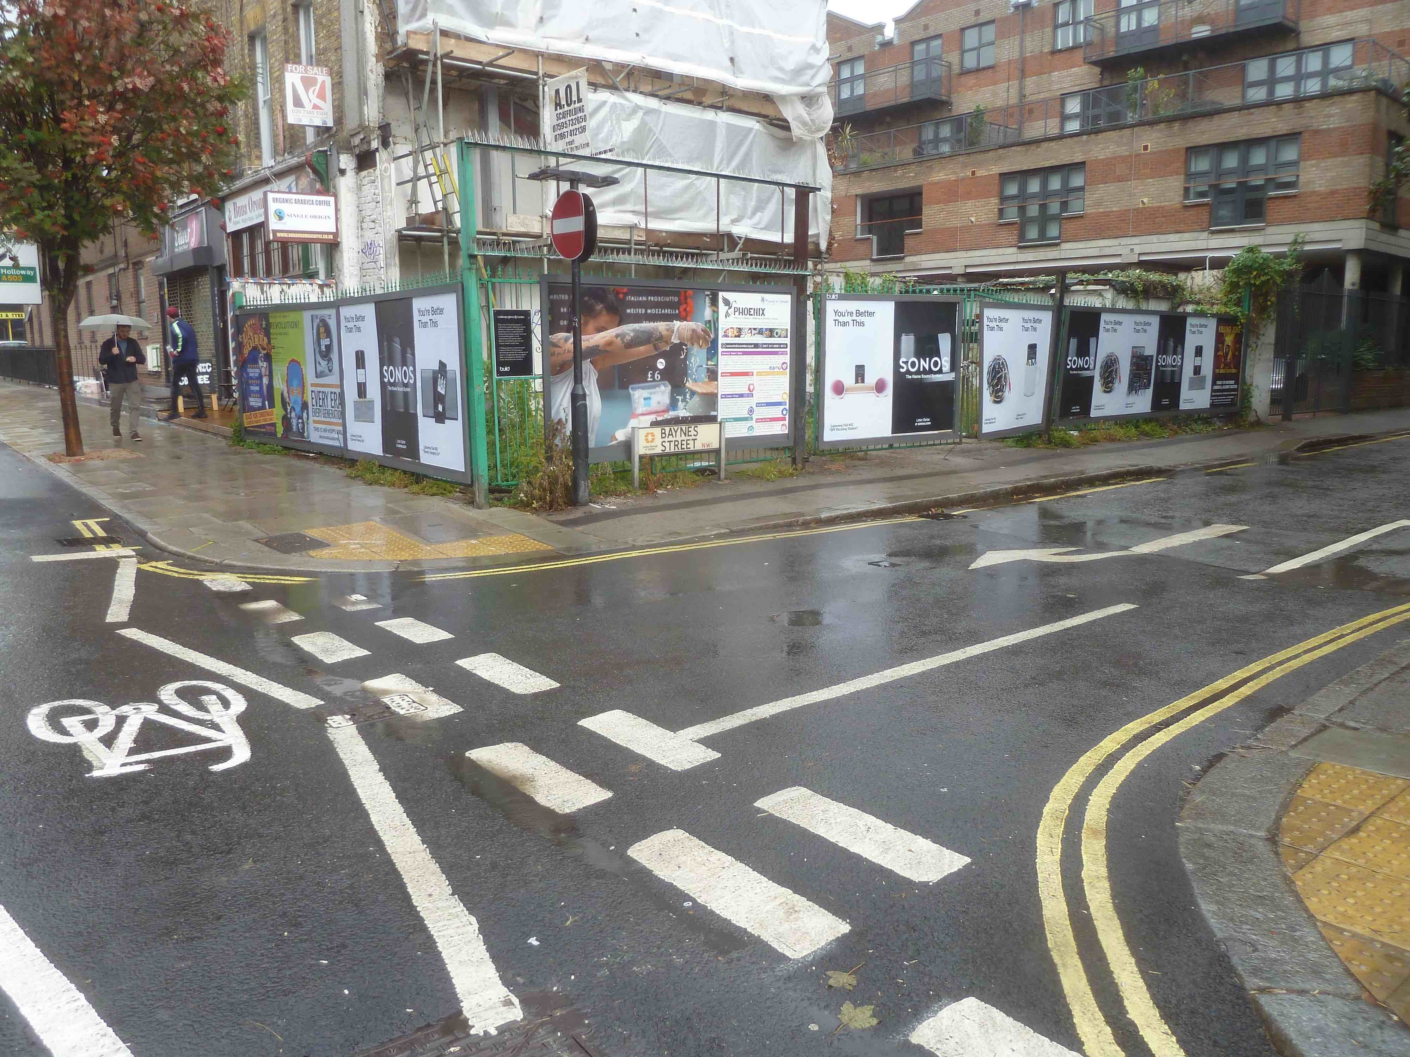
Current layout (a) – equivalent of 19 posters

Slide 4
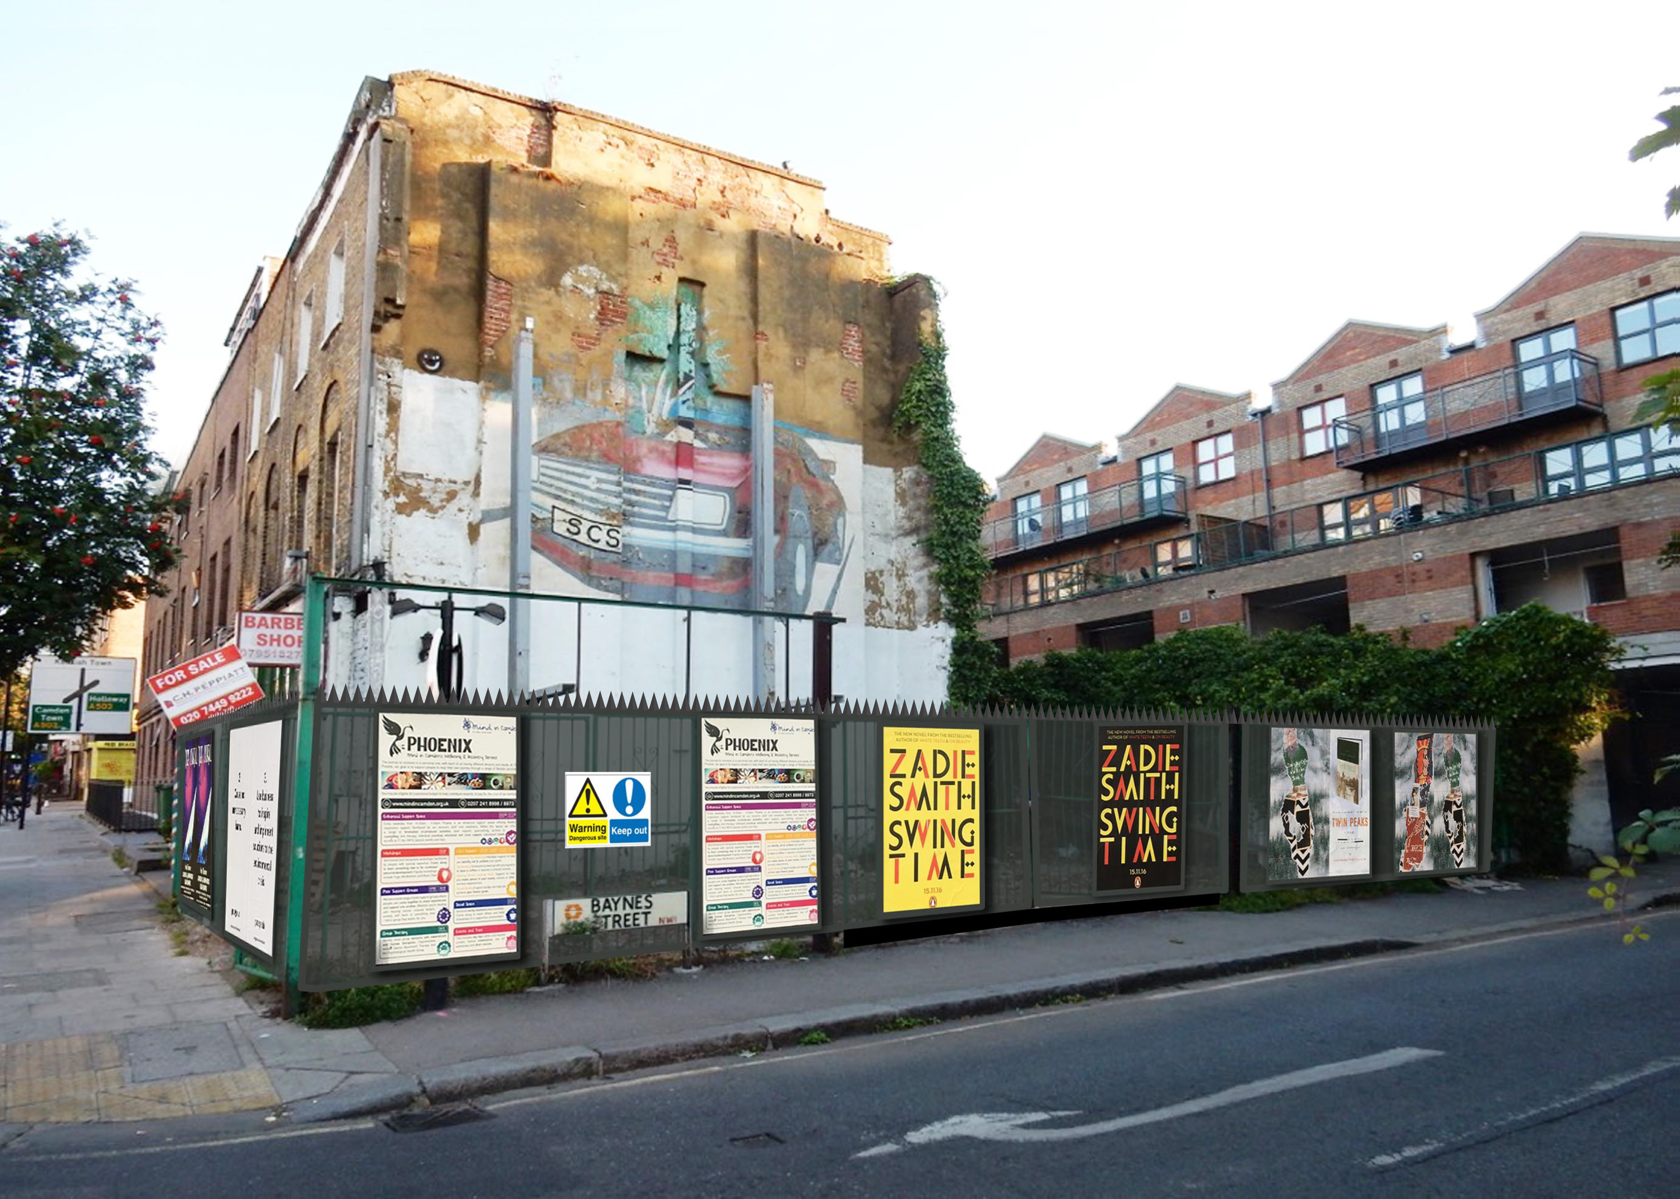
Royal College Street / Baynes Street proposed revised elevation a) (nb old photograph pre – scaffold). Equivalent of 12 posters

Slide 5
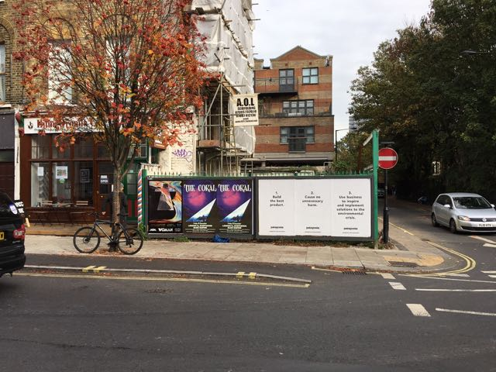
Royal College Street / Baynes Street
Elevation b) – existing layout

Slide 6
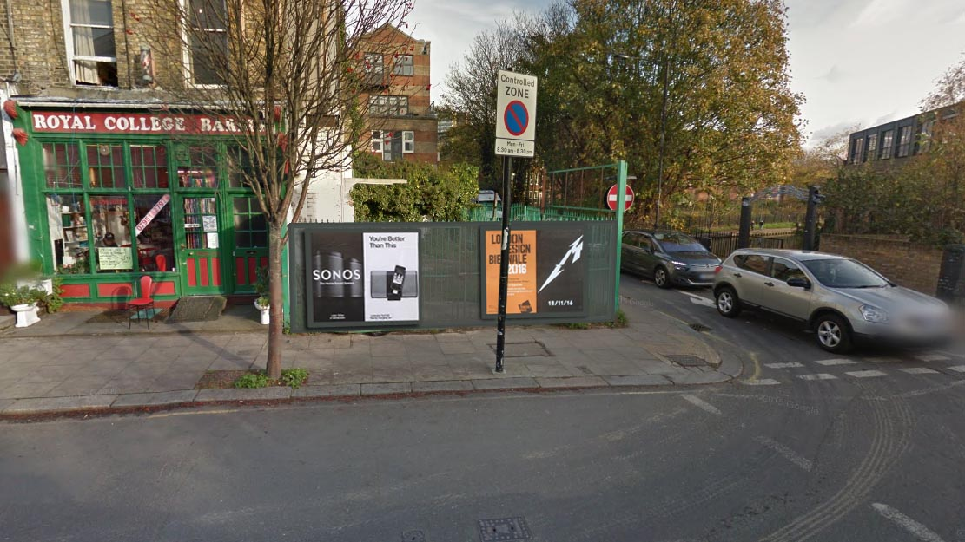
Royal College Street /Baynes Street
Proposed revised elevation 2

