Slide 1
Vodafone site 47008 – Troyes House
Date Prepared: 02nd September 2016

Slide 2
KEY TO COVERAGE PLOTS
The enclosed radio propagation plots are based on Ordnance Survey geographical information.
The level of coverage provided by a particular site is dependant on a number of variables. The main factors which determine the extent of coverage are: the frequency of the signal emitted, the height of the antenna above ground level, the characteristics of the surrounding topography and the type and occurrence of ground clutter such as buildings and trees which can cause ‘shadows’ or reflections and can absorb the signal.
The Radio Planners have produced accurate visual representations of the level of coverage available in this particular area by using advanced computer modelling software based on a Geographical Information System. The programme takes the numerous variables as above into account and can then calculate and plot the strength of the signal.
Key for Plots
Sufficient signal strength to provide adequate service for
Indoor
Pink
indoor use of a hand portable mobile in urban areas.
Dense
Urban
Orange
Sufficient signal strength to provide adequate service for
Indoor
indoor use of a hand portable mobile in suburban areas
Urban
Red
Sufficient signal strength to provide adequate service for
Indoor
indoor use of a hand portable mobile in suburban areas
Suburban
Green
Sufficient signal strength to provide adequate service for use
In Car
of a hand portable mobile in a car
Yellow
Sufficient signal strength to provide adequate service for
Outdoor
outdoor use of a hand portable mobile.
No
Insufficient signal strength to provide reliable service.
No
Colour
Coverage

Slide 3
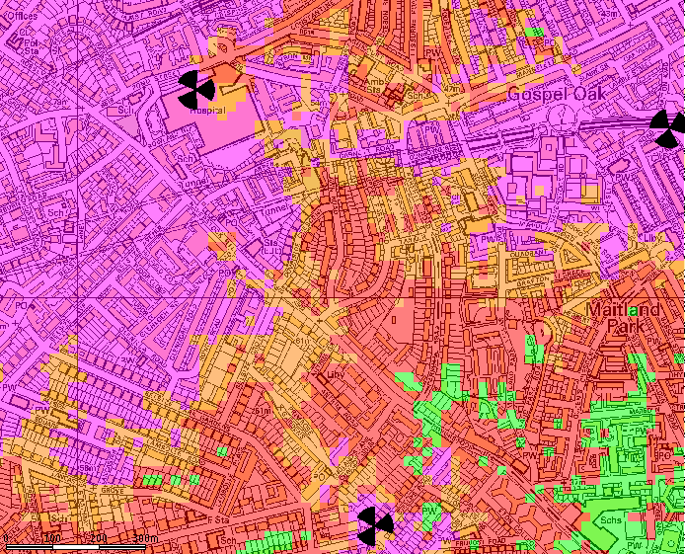
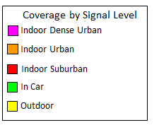
Vodafone Present 3G Coverage

Slide 4
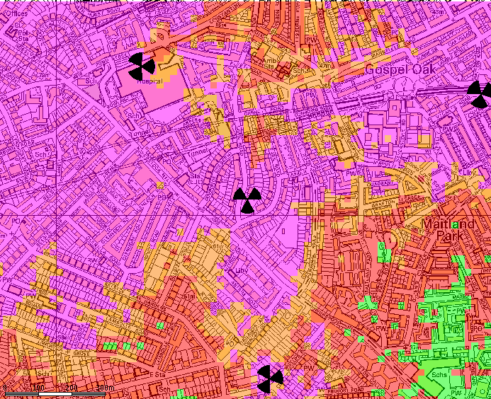
Vodafone 3G Future Coverage with VF47008

