Slide 1
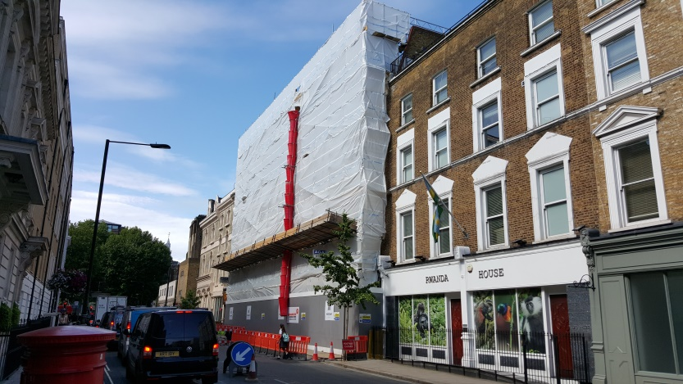

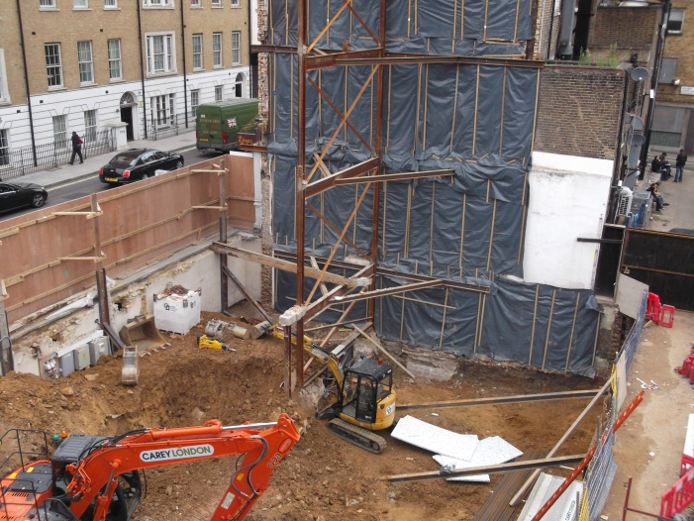
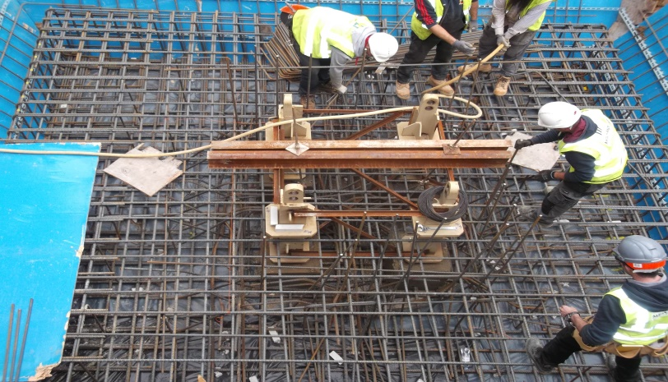

124 – 130 SEYMOUR PLACE
Newsletter
August 2015 /31/08/’15
Merchant Land aims to keep the surrounding neighbours up to date with all it’s construction progress and to limit any inconvenience which may be caused throughout the works. Please find below current progress on site;
Seymour Place
Dear neighbour, following the successful completion of the demolition works, we will now begin focusing all our efforts on beginning the basement and drainage aspect of the new building. We have once again, assigned specific days for the removal of material offsite, this the 1st element of the basement, known as the bulk dig. We will at all times comply with the current traffic management arrangements in place, and minimise any disruption to the traffic flow on Seymour Place, especially during excessive busy periods such as rush hour. With this element of work, and considering the time of year, the possibility of rain is generally higher. This causes the material to become quite messy, and any spillages or debris on the lorries may cause some marking. However, we have measures in place to ensure both the walkway & highway are never compromised, ensuring both your safety & the workforce are at all times.
Unfortunately, there will be the added noise pollution for approx another 2/3 weeks whilst we reach the basement formation level, but we will endeavour to keep this to a minimum throughout. The volume of material away will then dissolve, however being replaced with concrete & steel deliveries on various dates, but on a much reduced frequency during the month of september. Again, we will be very proactive in keeping disruption to the absolute minimum, avoiding any interface with rush hour, maintaining local traffic flow and keeping within the strict parameters of the traffic management plan agreed with the council. Finally, I would strongly advise all our neighbours, to adhere to the designated walkways/signage in place throughout the working hours, to ensure your own safety. Thank you for all your continued cooperation and I will update you again next month.
Walmer Place
Merchant land welcome feedback from our neighbours and local community, feel free to speak to the site management team or contact the office on 0207 5228742. Thank You for your support

