Slide 1
New site VF 83706
London Design Team

Slide 2
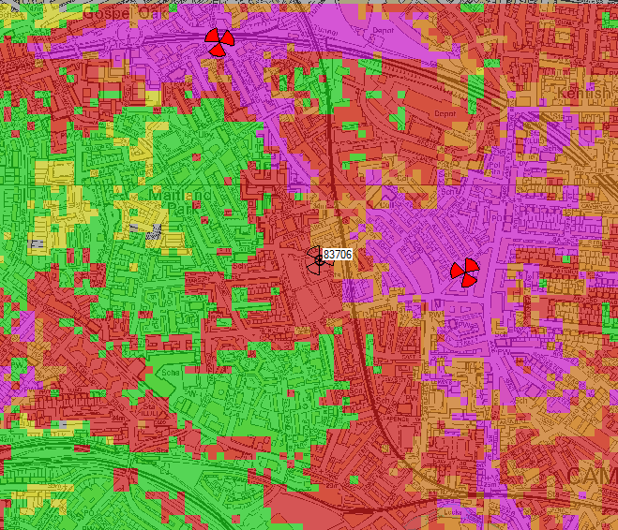
U2100 (3G) present coverage
3G Coverage by Signal Level
Indoor Dense Urban
Indoor Urban
Indoor Suburban
In Car
Outdoor

Slide 3
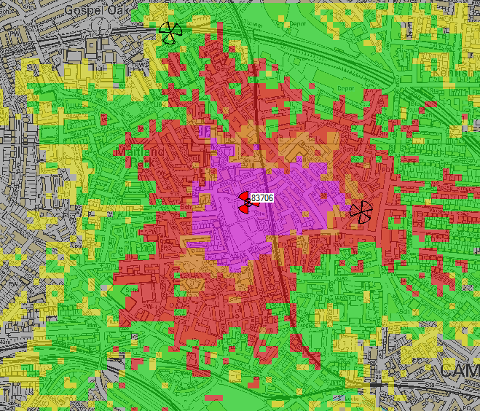
U2100 (3G) new site 83706 coverage
3G Coverage by Signal Level
Indoor Dense Urban
Indoor Urban
Indoor Suburban
In Car
Outdoor

