Slide 1
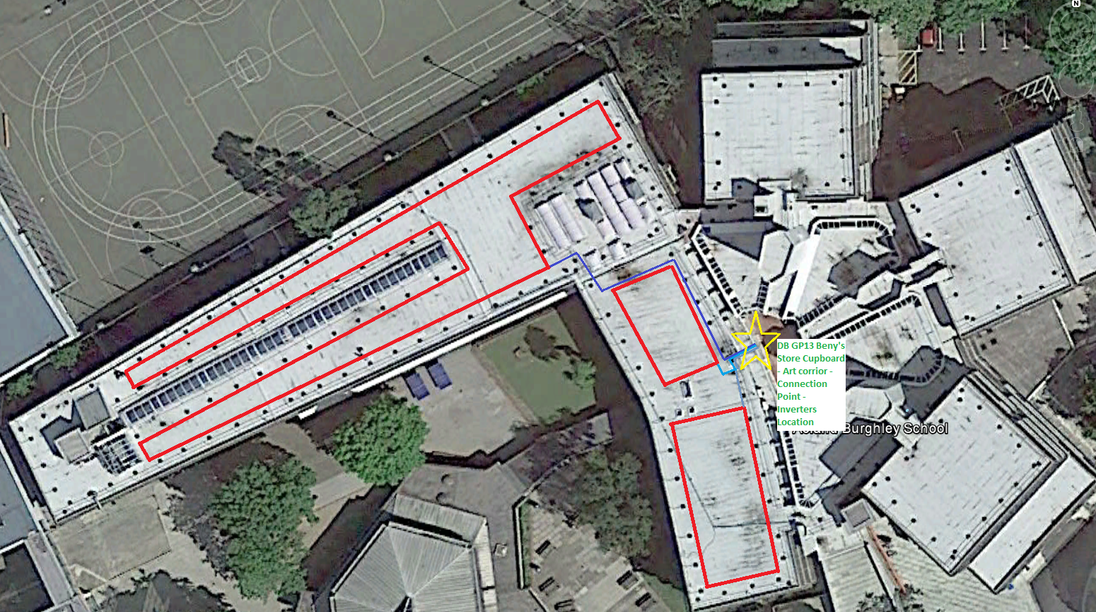
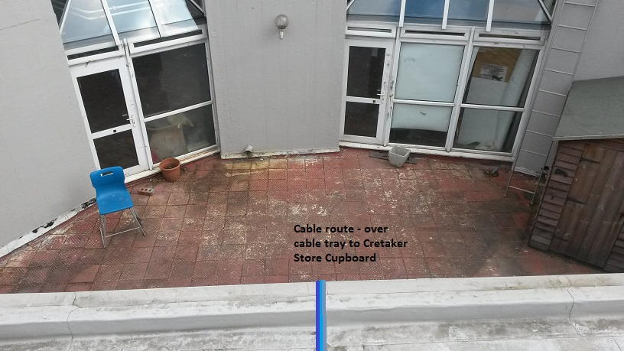
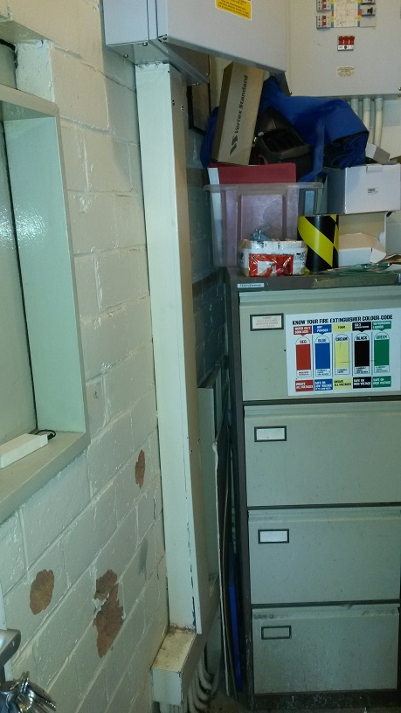
Beny’s Store Cupboard – connection Point – Inverters, Generation Meter Location

Slide 2
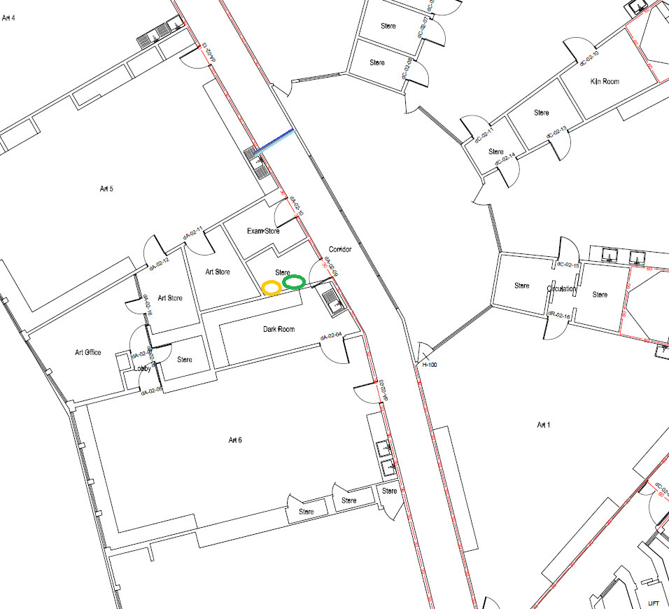
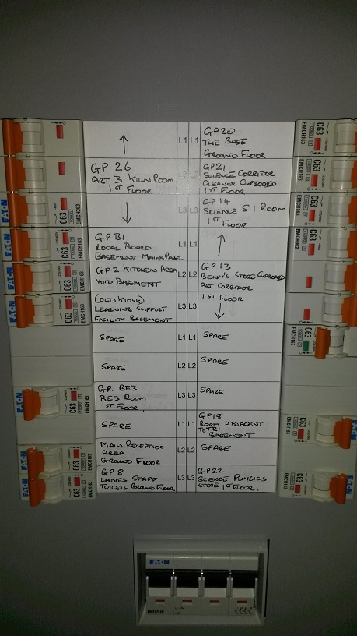
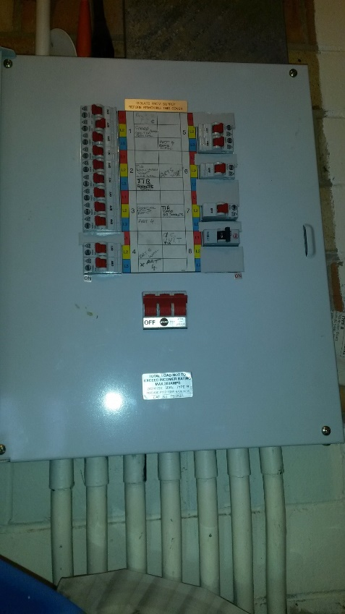
Drilling Point – Corridor External wall
External Cable Run – On roof on a cable tray
Internal Cable run – along the art corridor to Beny’s Store cupboard
Inverter location – Connection Point DB GP13

