Slide 1
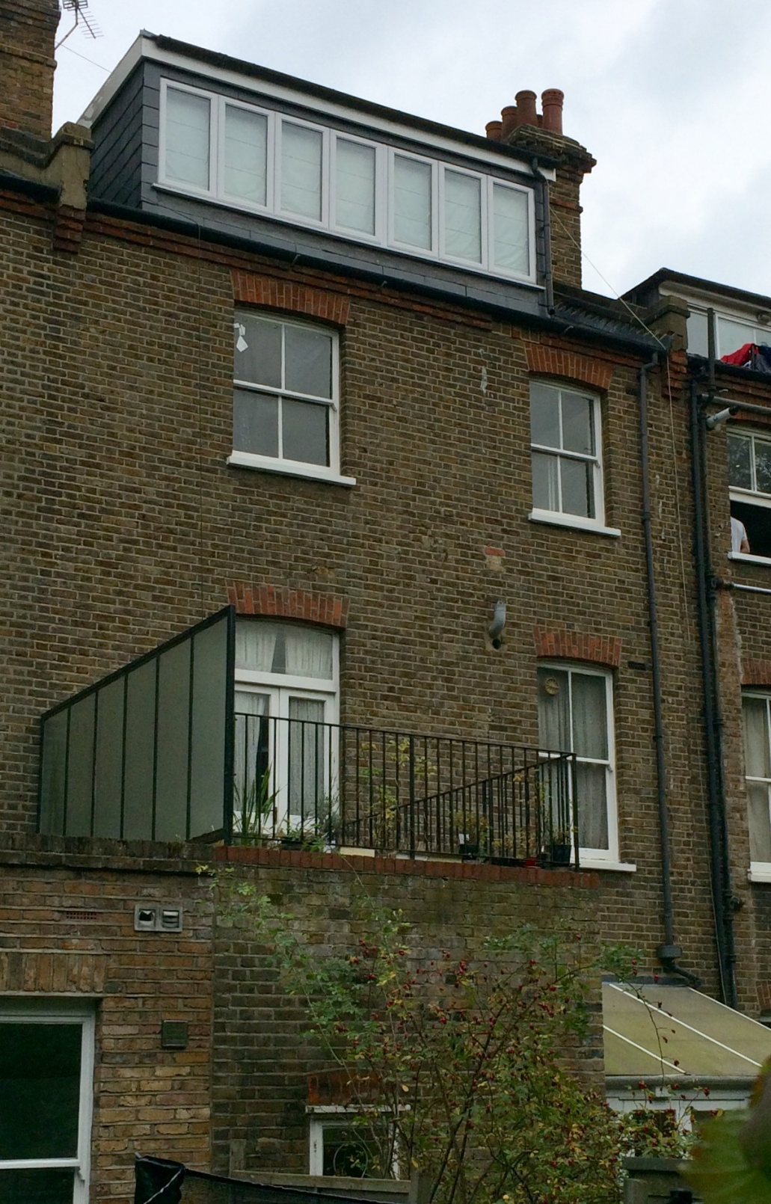
Loft flat – Flat 4
Flat 3
Flat 2
Ground floor - Flat 1

