Slide 1
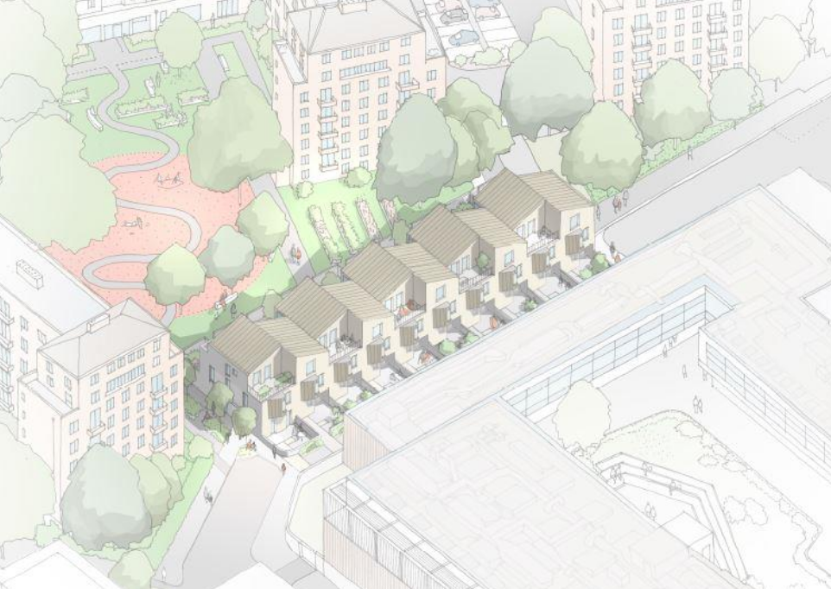
Look Book
GODWIN & CROWNDALE ESTATE, LONDON
Bid Ref: 23-G021
Project Name: Godwin & Crowndale Estate

Slide 2
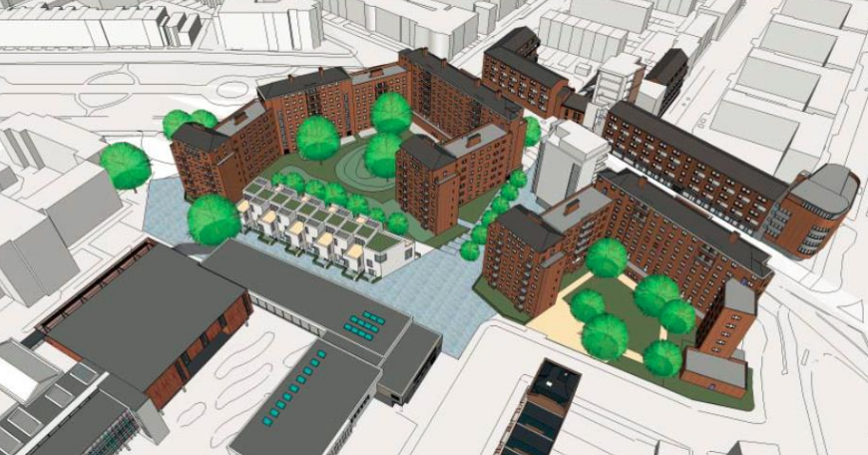
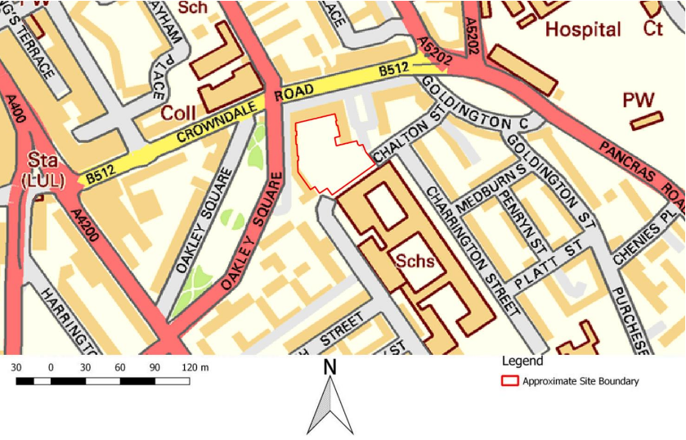
Main Site Considerations
Current use of site: Multi Use Games Area (MUGA), Private car park & communal landscaped gardens.
The site lies adjacent to the pedestrianised continuation of Chalton Street and close to the junction with Charrington Street. Part of the site is currently accessed through the existing open space of Godwin Court, whilst the existing enclosed private car parking element of the site is accessed via the Crowndale Court access road.
Maintaining the security of the site throughout the development by installing a robust 2.4m high timber perimeter hoarding, controlled access points during construction hours and out of hours security.
Protection of retained existing services on and around site and issuing permit to control works in the vicinity of live services.
Chalton street is a single carriageway road subject to 20mph speed limit and varies in width from 5 - 6m with parking bays located on both sides for the majority of its length.
Chalton Street has single yellow lines, footways and street lighting on both sides.
Chalton Street connects from Goldington Crescent in the north-east to Euston Road to the south with access restricted for vehicles due to the location of the site.
Ensuring that local roads are not affected by construction deliveries to and from site including congestion, parking and cleanliness of road.
Ensuring local stakeholders are continually updated on site progress and that they have direct contact with site team to discuss any matters they have.

Slide 3
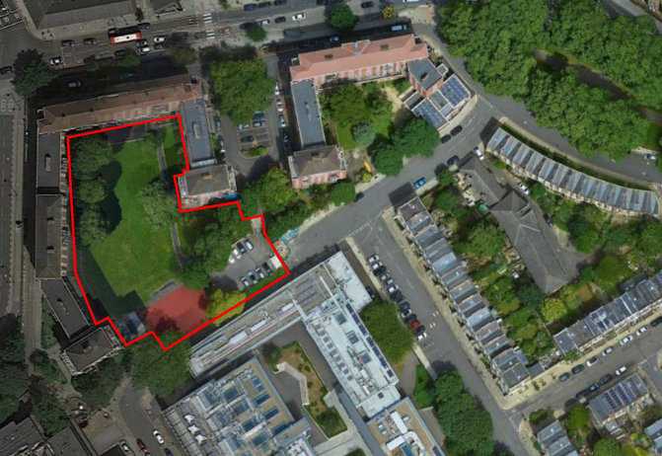
Key Constraints
Site is mostly surrounded by a large number of low to mid-rise residential buildings and a three-storey education building (Camden City Learning Centre) \ Regent High School to the Southern boundary of the development.
Logistics – movements of plant and deliveries in and out of a tight site in a busy urban context.
Limited site storage and welfare facilities.
Noise and dust will be controlled by the Considerate Contractors Code.
Any utilities running through the sites will be checked and liaison with utility companies carried out if required.
Existing services (gas, electric & water) to be diverted and relocated.
Ensuring public safety is priority when working adjacent or outside of the site boundary.
Ensuring there are control measures in place to combat dust during concrete\tarmac breaking activities. Any rubble and spoil generated will be stored for re-use if possible.
Ensuring that Noise and dust caused through the construction works are planned, monitored and controlled.
A license will be sought from LBC where the work is required to be carried out over part of the public footpath.
Site Layout Plan

Slide 4
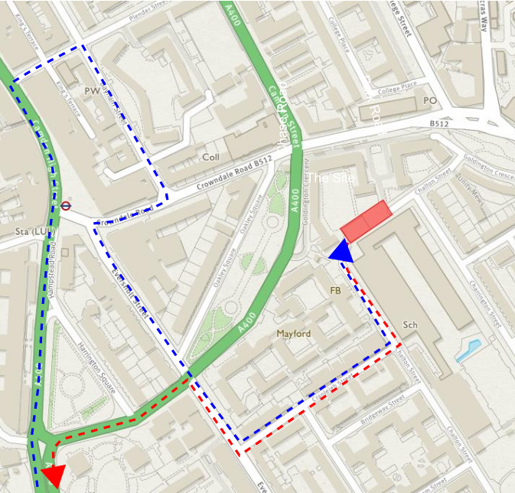
Site Delivery Route
Delivery route to the site will be via “Commercial Road” (Euston road / A501) to the south and then turn left onto the A400 Hampstead road, continue onto Camden high St, turn right to Plender St, turn right to Bayham St, turn right to Crowndale road, turn left onto Eversholt St turn left to Cranleigh St and then turn left onto Chalton St to access the site.
On exiting the site construction traffic will head south-east on Chalton St towards Cranleigh St, turn right onto Cranleigh St, turn right onto Eversholt St, turn left onto Lidlington Pl before joining the A400 Hampstead road and re‐joining the Euston Road / A501.

Slide 5
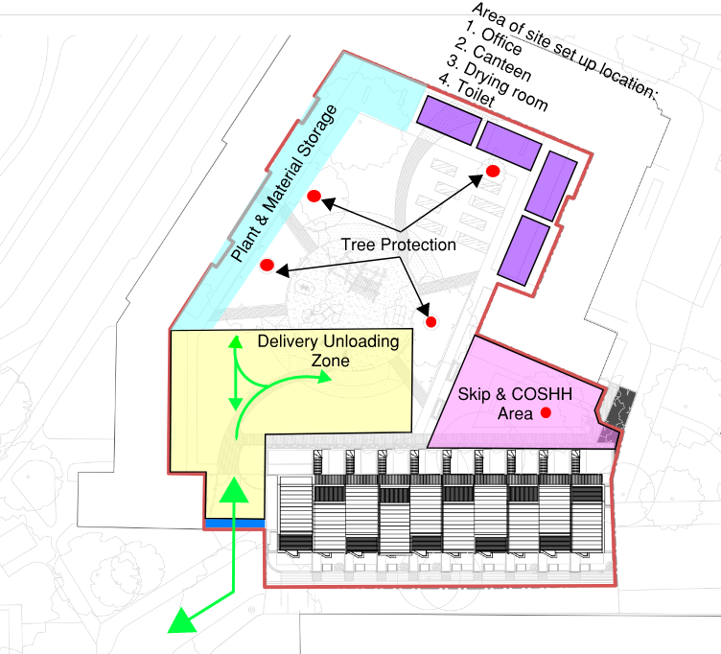
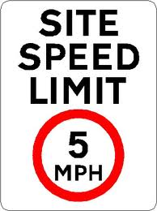
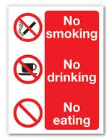
Site Logistics Proposal
Main Criteria
Site accessed via Chalton Street.
Single access in and out to site.
Site offices, welfare units and material stores will be provided within the site at the North boundary.
Jet wash facility will be installed at site entrance mainly during groundworks period.
A Waste & Recycling Action Plan will be implemented, with site segregation of waste and maximum on and off-site recycling.
A suitable number of trained traffic marshals \ banksman will supervise arrival and departure of all construction traffic throughout the project.
All vehicles will enter and exit site in a forward position.
All site operatives \ visitors will access the site using a safe pedestrian segregated site entrance.
There is no parking available on site for Operatives or Visitors.

Slide 6
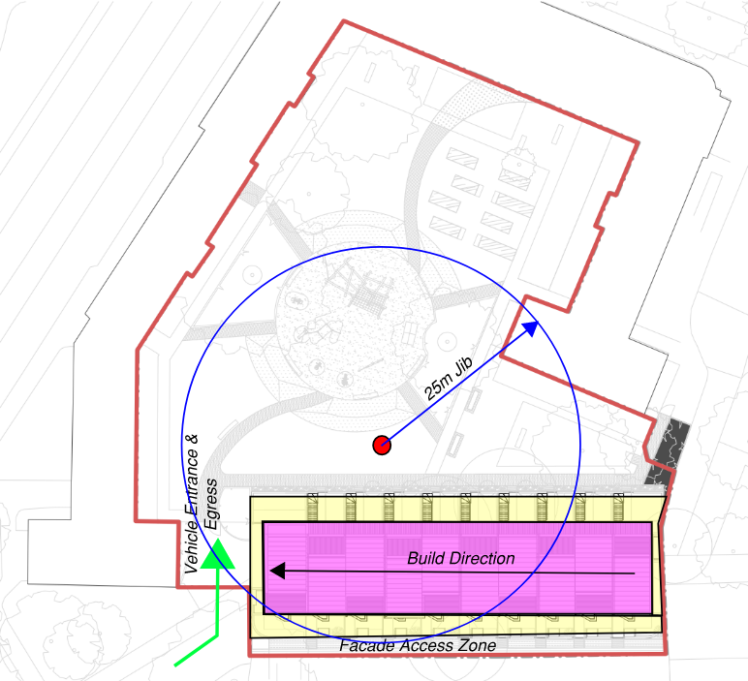
Build Methodology
Legend
Site boundary
Primary Construction Sequence
1. Form site hoarding, access gate, remove existing MUGA, private car park & level area.
2. Divert services and install load bearing piles.
3. Excavate and construct foundations, below slab drainage and beam & block ground floor slab.
4. Erect load bearing masonry, structural steel beams and timber or hollowcore PCC planks.
5. Construct building envelope - brickwork, windows, doors and roof.
*WEATHERTIGHT*
6. Mechanical and Electrical installation
7. Internal finishes and fit out
8. External works including refuse store, cycle store, generator room and substation.
9. Testing and commissioning.
10. Clean and Handover

Slide 7
Offsite Elements
Off-site pre-fabrication Plan |  | Reason
Not Applicable

Slide 8
List of sensitive receptors
Address | Type of receptor (dwelling, place of worship, school, business substation, etc) | Impacts (Dust, Noise, Vibration |  |  | Controls (done by Health and Safety not planner)
 |  | Dust | Noise | Vib
Godwin Court, London NW1 1NW | Residential Area | Medium | Medium | Medium
Crowndale Court, London NW1 1TY | Residential Area | Medium | Medium | Medium
Camden Learning Centre (South Boundary) | School | Medium | Medium | Medium

Slide 9
Noise Dust and Vibration
List of sensitive receptors | Address
Building Name | Address
Godwin Court - Housing Block | Crowndale Rd, London NW1 1NW
Crowndale Court – Housing Block | Crowndale Rd, London NW1 1TY
Camden Learning Centre | Charrington St, London NW1 1RD
Regent High School | The Medburn Centre, 136 Chalton St, London NW1 1RX
Notes:
following precautions will be made to minimise nuisance to the public and neighbouring occupiers caused by noise:
• Noise shall be reduced by the use of silencing devices at all times and noisy operations shall be in accordance with Local Authority requirements;;
• All loading, unloading and deliveries of materials and plant to the site and removal of waste should, where possible, be carried out within normal site working hours;
• Utilisation of the right machine for the right job ensuring that plant is not under-powered to carry out the task and hence, generating more noise or more vibration than necessary;
• Use of modern intrinsically compliant plant and equipment ensuring noise and vibration levels are minimised at the outset (all equipment must comply with the EC Directives and UK Regulations set out in BS 5228-1:2009);
• Use of physical barriers (of at least 5 kg/m2 surface density), for example, hoarding, monoflex covering on scaffold to reduce noise emissions;
• Siting of stationary plant and loading/unloading areas away from site boundaries and/ or within screened areas;
• Using electrically powered equipment run from the mains supply where available is preferred to using generators to power plant and equipment ;
• Use of screws and drills rather than nails for fixing hoardings etc.;
• careful handling of materials & waste such as lowering rather than dropping items;
avoidance of unnecessary noise (such as engines idling between operations, shouting, loud radios or excessive revving of engines) by effective site management;
• Pre and post task reviews of working practices and ensuring noise risk is addressed and reduced to acceptable levels;
• Toolbox talks with trained project staff to update operations on potential and current noise level impacts;
• Careful planning of the sequence of work in order to minimise the transfer of noise/vibration to neighbours.

Slide 10
Welfare (Standard size seems to be 32’x 12) | Yes/No | Details as appropriate (e.g. numbers, dimensions)
Modular, Traditional? | Modular | 4 nos
Stacked Cabins? | Yes
Project Office | Yes | 1 no
Meeting Room \ Induction | Yes | 1 no
Designated smoking area | Yes
Designated eCig area | Yes
Site Canteen | Yes | 1 no
Drying Room | Yes | 1 no
Toilets/Washing | Yes | Male No:1 Female No:1 Gender Neutral No: xx
Heating Food | Yes
Wheel washing provided | No
Wi-Fi | Yes
Prayer Area | Yes
Rest Area | Yes
Microwave | Yes
Electric supplies (Mains, Generator, Use of Existing) | Yes | Mains
Water supplies (Mains, Temporary) | Yes | Mains
Drainage (Mains, Temporary) | Yes | Mains
Will waste be segregated on site? (Y/N) | Yes
Waste skips provided for (make sure waste skip location showed on plan) | Yes
Mortar Silo | Yes
Truck Staging Area | No
Crane base | No
Security Strategy (Add as appropriate)
 | Numbers | Details as appropriate
CCTV | Location and no TBC | Yes
Description of site hoardings | Yes | Hardwood ply (minimum 2.4m high excluding headers and kickers) on timber posts and rails.
Manned guards |  | No
PIR Lighting

Slide 11
 | Number required
No of loading/unloading bays on SLP | NA
Construction workforce at peak | 30 to 40
No of car parking spaces allocated on site | none
No of cycle spaces allocated on site | none
Working Times
Monday - Friday | 08.00 and 18.00
Weekend | 08.00 and 13.00 on Saturdays
Delivery Time slots
Monday - Friday | 09.00 and 17.00
Weekend | 09.00 and 12.00 Saturdays
Site management will avoid delivery slots at peak hours due to neighbouring school & learning centre.

Slide 12
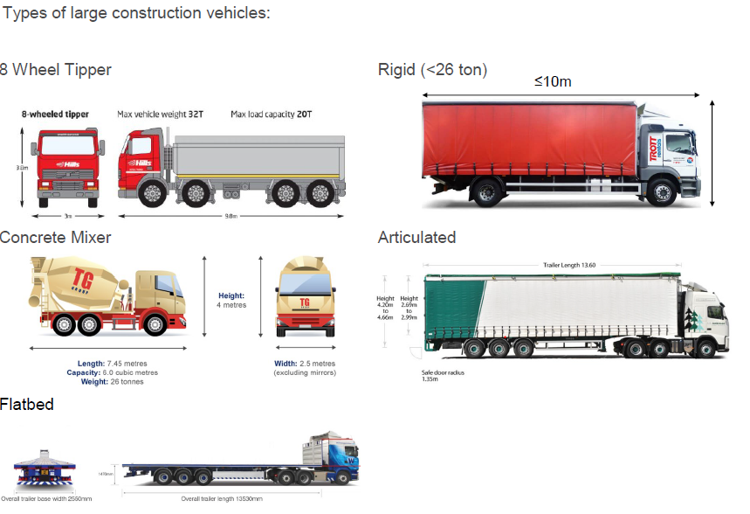
Vehicle deliveries profile
Construction Activity | Type of Vehicle | Size of Vehicle | Number of Movements (Daily) | Duration
Demolition \ Strip Out | 6 or 8 Wheel Tipper | 10m x 2.4m | 8 | Short
Substructure | 6 or 8 Wheel Tipper | 10m x 2.4m | 6 | Short
Foundations - Concrete | Concrete Mixer | 7.5 x 2.5m | 4 | Short
Floor Slab Concrete Pours | Concrete Mixer | 7.5 x 2.5m | 4 | Medium
Brick \ Blocks | Rigid | 10m x 2.55m | 6 | Medium
Building Envelope | Rigid | 10m x 2.55m | 6 | Medium
Roofing | Rigid | 10m x 2.55m | 4 | Medium
Fitout | Rigid | 10m x 2.55m | 6 | Medium

Slide 13
Abnormal Loads
Description | Yes \ No | Type of vehicles
Office/Welfare Cabins | Yes | Rigid Vehicle
Piling Plant | No | NA
Mobile Cranes | Yes | Rigid Vehicle
Large Excavators | Yes | Rigid Vehicle
Crushing Plant | No | NA
Articulated vehicles
Rigid Vehicle
Sprinter
Drop Side
Curtain Sided
Tipper
Abnormal loads are those that require special traffic movement agreements with the local highways authority and/or the Traffic Police, these are generally loads of excessive length or width.
Notes:
The appropriate traffic movement orders will be agreed with the relevant statutory authorities prior to delivery or collection of any abnormal loads. It is often a requirement for abnormal loads to be delivered or collected outside of busy traffic periods. We will therefore issue special notice to our neighbours prior to any abnormal loads being delivered or collected. Upon delivery/collection the abnormal load will be directed to a pre-agreed delivery area by the traffic marshal who will instruct the driver to turn off the vehicle engine and switch off any lights to await unloading/loading. Following unloading/loading the vehicle will wait in until it is permitted to leave at a pre-agreed time as defined within the traffic movement notic

Slide 14
Potential disruptions to neighbours
 | From | To | Reason | Details (e.g. name of road)
Footway Closure | Yes |  | Gas service diversion \ relocation. | Chalton Street
Footpath Diversion | No
Possible Future Road Closure | NA
Parking Bay Suspension | NA
Significant Noise requiring advance notification (may be more than once over the project duration – add lines as required) | NA
Significant Dust requiring advance notification (may be more than once over the project duration – add lines as required) | NA
Significant Vibration requiring advance notification (may be more than once over the project duration – add lines as required) | NA
Bus stop/other (please state) relocation | NA
Services interruptions (may be more than once over the project duration – add lines as required) | NA

Slide 15
Noise Dust and Vibration
Specific (as opposed to generic control measures) | Yes/No
Dust monitoring stations equipment? If yes consider showing locations on plan | Yes
Vibration monitoring equipment used. If yes, consider showing locations on plan | Yes
Noise monitoring equipment used? If yes, consider showing locations on plan | Yes
Monarflexed Scaffold | Yes
Acoustic Hoarding/Envelopes | No
Enclosures | No
Water Mist Suppression | Yes
Smart Sensors | No
Echo barriers | No
Noise cancelling headphones for vulnerable residents and pets | No
‘silent’ piling techniques | No
Power floating exhaust silencer (Power floating of concrete slabs) | No
Skip linings to reduce noise | No
Apps to provide live alerts | No
Notes:
following precautions will be made to minimise nuisance to the public and neighbouring occupiers caused by noise:
• Noise shall be reduced by the use of silencing devices at all times and noisy operations shall be in accordance with Local Authority requirements;;
• All loading, unloading and deliveries of materials and plant to the site and removal of waste should, where possible, be carried out within normal site working hours;
• Utilisation of the right machine for the right job ensuring that plant is not under-powered to carry out the task and hence, generating more noise or more vibration than necessary;
• Use of modern intrinsically compliant plant and equipment ensuring noise and vibration levels are minimised at the outset (all equipment must comply with the EC Directives and UK Regulations set out in BS 5228-1:2009);
• Use of physical barriers (of at least 5 kg/m2 surface density), for example, hoarding, monoflex covering on scaffold to reduce noise emissions;
• Siting of stationary plant and loading/unloading areas away from site boundaries and/ or within screened areas;
• Using electrically powered equipment run from the mains supply where available is preferred to using generators to power plant and equipment ;
• Use of screws and drills rather than nails for fixing hoardings etc.;
• careful handling of materials & waste such as lowering rather than dropping items;
avoidance of unnecessary noise (such as engines idling between operations, shouting, loud radios or excessive revving of engines) by effective site management;
• Pre and post task reviews of working practices and ensuring noise risk is addressed and reduced to acceptable levels;
• Toolbox talks with trained project staff to update operations on potential and current noise level impacts;
• Careful planning of the sequence of work in order to minimise the transfer of noise/vibration to neighbours.

Slide 16
List of temporary works
List of temporary Works | Required? (Y/N)
Simple and/or potentially low risk temporary works
Standard scaffold | Y
Formwork less than 1.2m high | N
Hoarding and fencing up to 1.2m high | N
Simple propping schemes – 1 or 2 props | Y
Internal hoarding systems and temporary partitions not subject to wind loading | N
Shallow excavations less than 1.2m deep/high | Y
More complex and/or potentially medium risk temporary works
Falsework up to 3m high | N
Formwork for columns and walls up to 3m high | N
More complex propping schemes – multiple props at single level | N
Needling of structures up to 2 storeys high | N
Excavations up to 3m deep/high | N
net systems not fixed to robust primary members | Y
Hoarding and fencing up to 3m high | Y
Simple designed scaffold | Y
Temporary roofs | N
Complex and/or potentially high risk temporary works
Falsework and formwork over 3m high | N
Trenchless construction, including headings, thrust bores, mini tunnels | N
Working platforms for cranes and piling rigs | N
Tower crane bases | N
Façade retention schemes | N
Flying and raking shores | N
Complex propping schemes – multiple props and multiple levels | N
Needling of structures greater than 2 storeys high | N
Ground support schemes greater than 3m deep | N
Complex designed scaffold | N
Cofferdams | N
Bridge erection schemes | N
Jacking schemes | N
Complex structural steelwork and precast concrete erection schemes | N
Hoarding and fencing over 3m high | N

Slide 17
List of applications and consents
 | Yes/No | Reason
Section 278 | No
Section 38 | No
Application for a permit to occupy the road in connection with building work | No
Application to temporarily close a road | No
Application to place portable traffic lights on the road | No
Hoarding licence | No
Skip licence | No
Crane oversailing licence | No
Permissions from adjoining owners | No
Temporary Stopping Up Orders | No
Parking suspensions | No

Slide 18
Mitigation Measures
Mitigation Measures
All deliveries will be scheduled, adherence to designated routes and avoid delivery during peak hours.
To avoid more than one vehicle attending the site at any time, all construction vehicle drivers must confirm site arrival time at least 20 minutes prior to arrival with the site manager by phone and only approach the site once confirmation that site is clear is received.
Preventing HGV movements during school drop-off and pick-up periods.
Trained and qualified traffic marshal \ Banksmen will be appointed to carry out traffic management procedures during the works.
Smart procurement procedures will be used to reduce on-site costs and minimise waste, while achieving a 'right first time' delivery.
Re-use of material on-site.
Appropriate fencing / hoarding.
Collaboration amongst other sites in the area
Implement a staff travel plan
Local residents / neighbours will be supplied with regular newsletters keeping them up to date with what has and will happen on site.

